Slide 1

servers
Notes:
Quick intro to serverless
Maturity model
Wardley map, discussion on utilities
Benefits / ideas about how this changes everything
Adoption ideas
Focus on high value changes
Challenges to implement
Experiences at GameStop

Slide 2



Slide 3
Your business doesn’t have technology problems

Slide 4


Slide 5


Slide 6
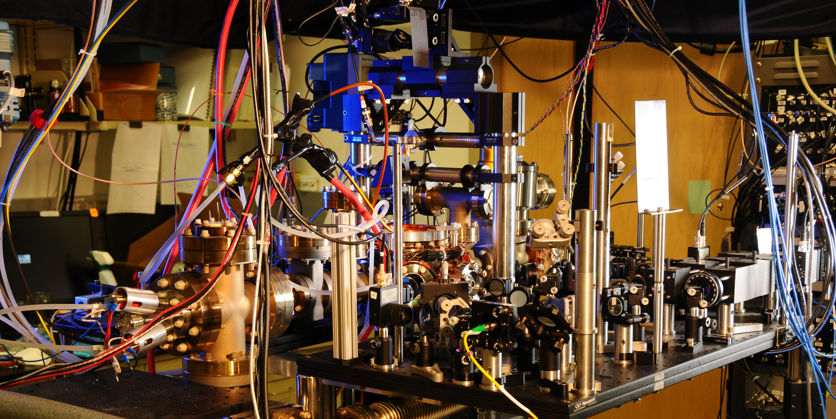
Notes:
Spanner ( Google’s modern relational database management systems that seek to provide the same scalable performance of NoSQL systems for online transaction processing (OLTP) read-write workloads while still maintaining the ACID guarantees of a traditional database system.^{[)1][2][3])}

Slide 7
You still have problems
Notes:
Staying relevant (MySpace) - Facebook
Scaling globally (?)
Reaching new demographics (Netflix launches to 60 countries)
Avoiding political pitfalls
Creating new products/services
Staying price competitive
Adapting to change (Blockbuster)

Slide 8


Slide 9
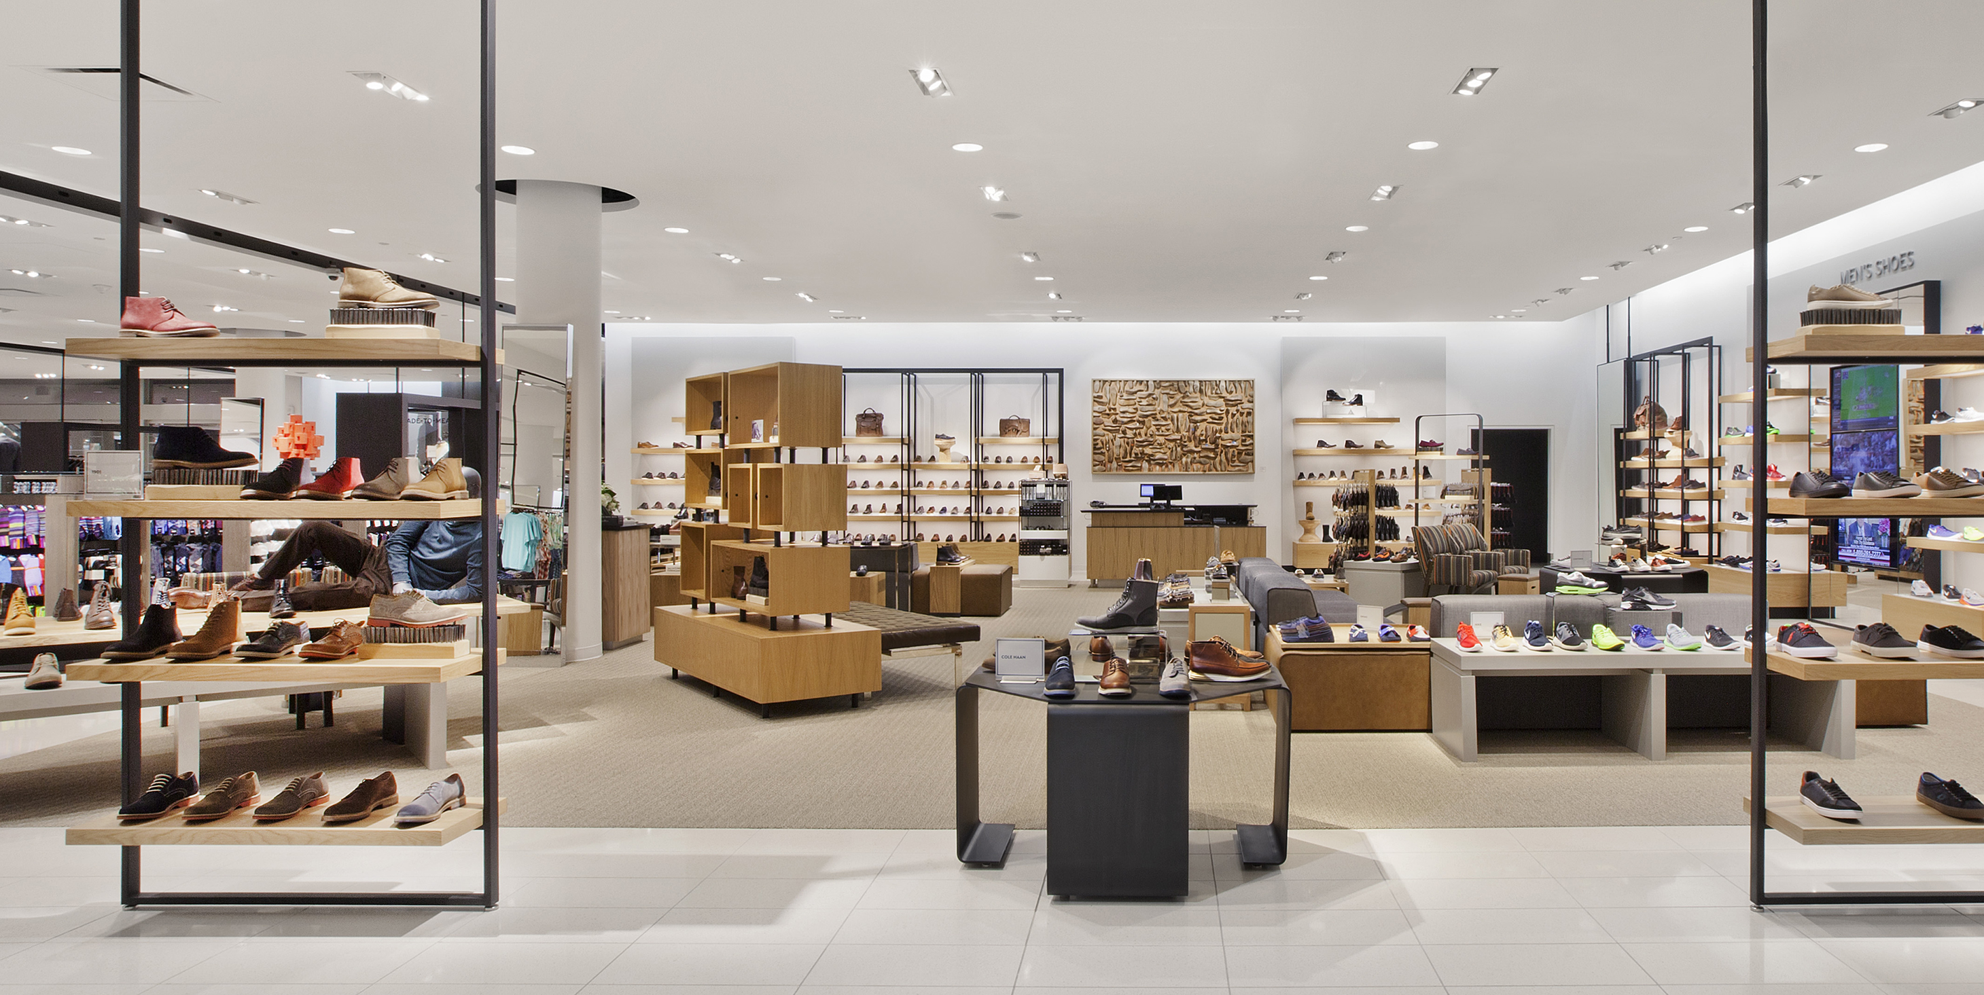

Slide 10


Slide 11
You don’t have technology problems
Solving technology problems isn’t your business

Slide 12
How much time does IT spend on solving business problems?

Slide 13





20 - 40%
40 - 60%
60 - 80%

Slide 14
You already know what you should be doing to improve this

Slide 15
We have nothing new to say about what you should be doing

Slide 16
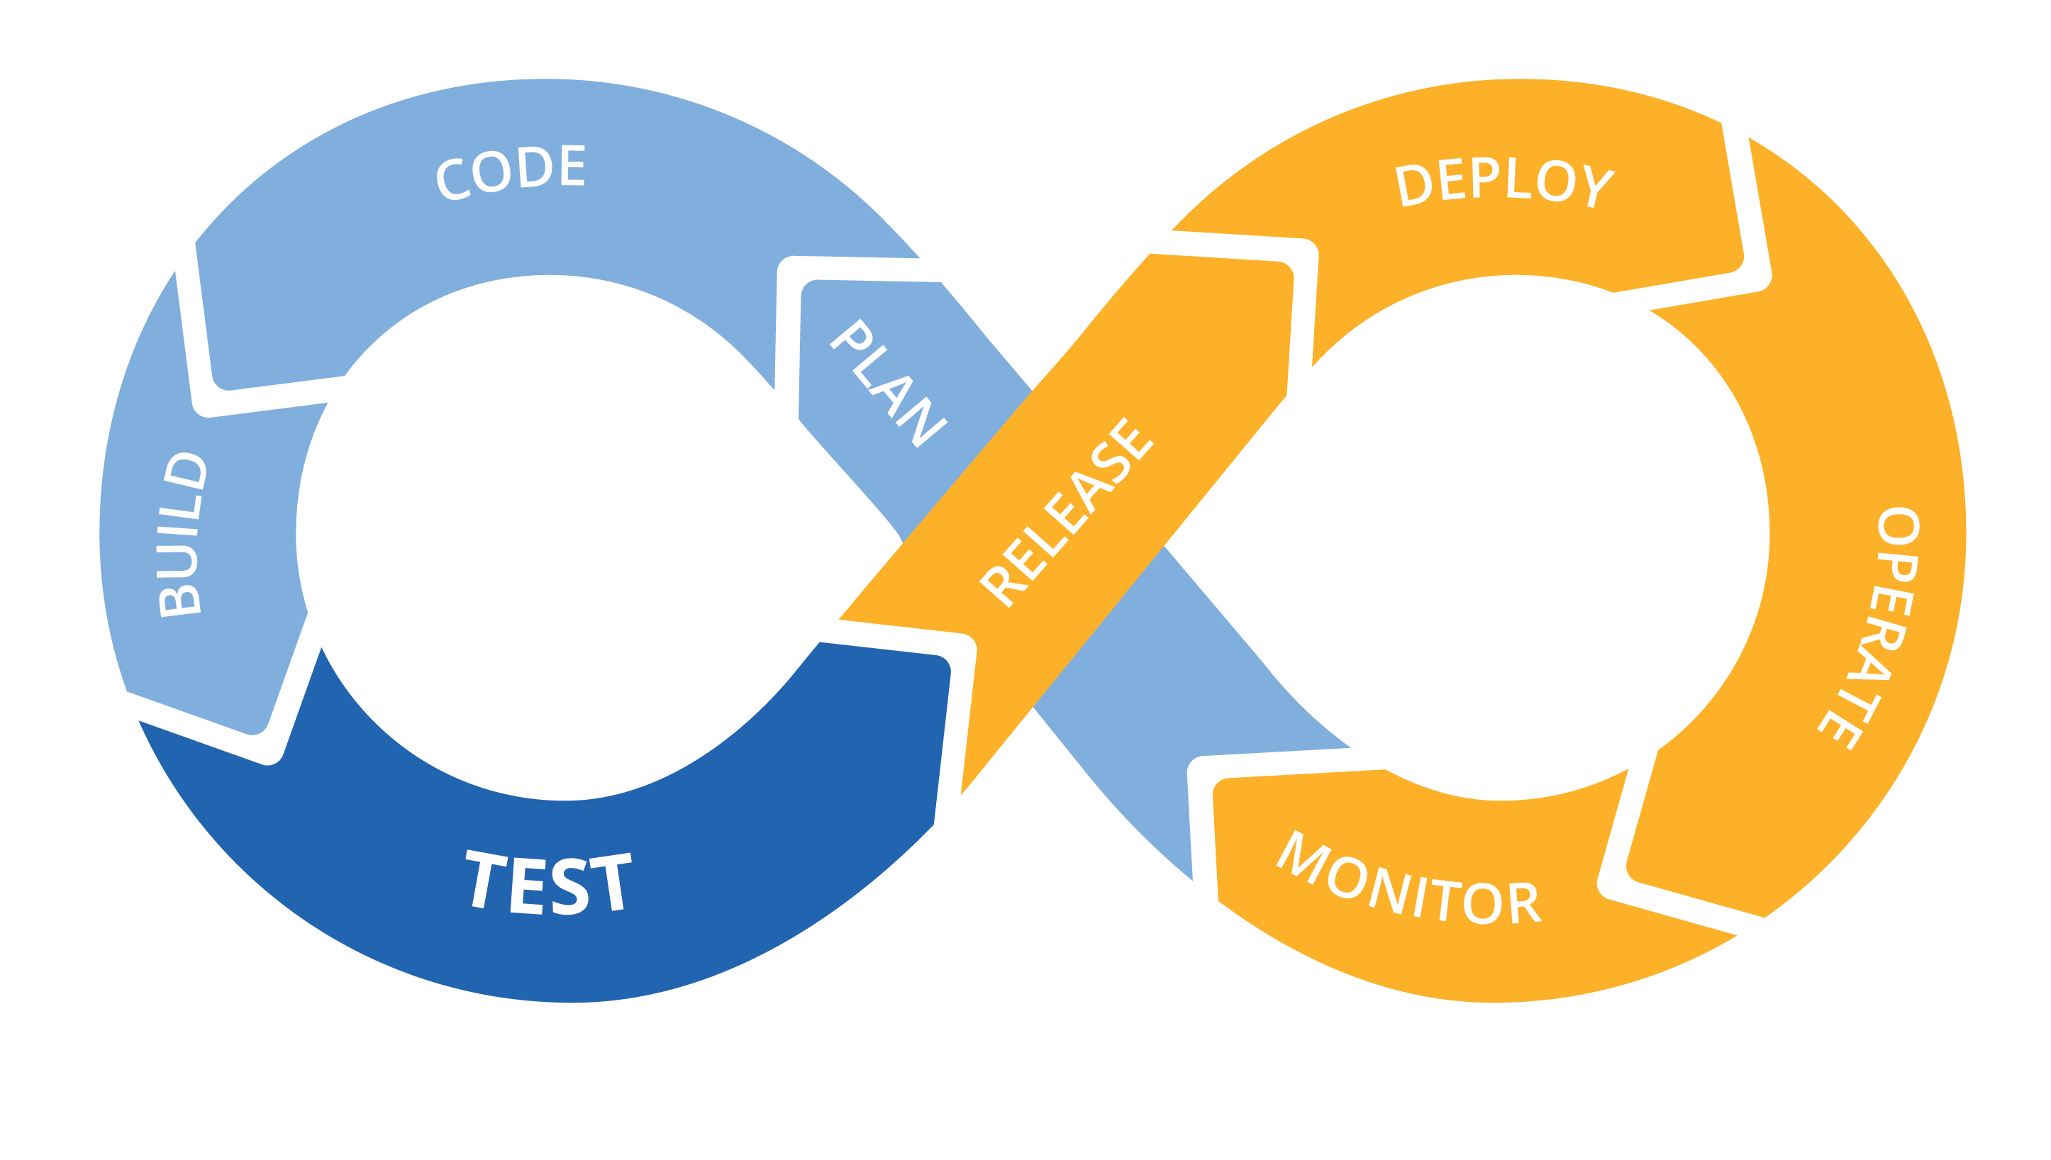
Notes:
Infrastructure as code
CI/CD for increased speed and stability
Monoliths to microservices to functions
Small teams, highly cohesive and loosely coupled
Only pay for what you use
Polyglot – the right language/framework for the job

Slide 17
Why have so few done it?

Slide 18
Energy
 | Time
Activation energy

Slide 19
Energy
 | Time
Difficulty of the change
Time required for change

Slide 20
Energy
 | Time
Catalysts change the equation

Slide 21
Energy
 | Time
Serverless changes the equation
Catalysts change the equation

Slide 22
What is serverless?

Slide 23


f(n) + +

Slide 24

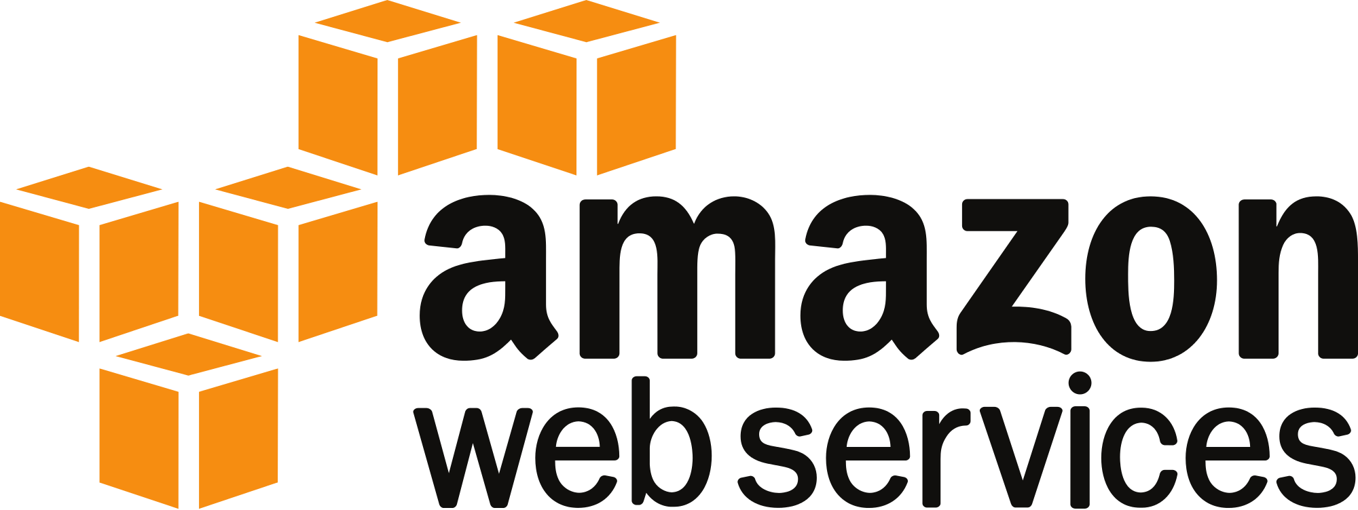
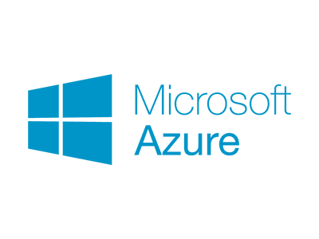


f(n) + +

Slide 25



Serverless as catalyst
Notes:
True variable cost computing
Time to market goes from months or weeks to days or hours
Built in support for things you should be doing already
Infrastructure as code
API driven development and data analysis to inform product development
Small teams
It’s like magic – haven’t met a developer who didn’t love it
Easy to use, easy to experiment with
Low cost to learn, develop with, experiment with – only cost is time, no infrastructure or hosting
Starts a chain reaction across your organization

Slide 26


Slide 27


Slide 28

Data driven decision making

Slide 29

Small, product focused teams

Slide 30

Cloud adoption & automation

Slide 31

Discovery through experimentation
Notes:
If relying on large efforts to change the organization and add business value, putting all your eggs in a single basket
Implies being able to clearly see the end from the beginning
Huge opportunity cost
Feel your way along and change to what’s working better

Slide 32


Unique value proposition to DevOps laggards
Notes:
Everyone, but the value will you get is inversely related to the investments you have made in DevOps and the cloud already
For mature DevOps and cloud companies the benefits will be more incremental because they are already following best practices
For companies without strong DevOps or cloud practices the value is much higher

Slide 33
(Not so) Bold Predictions

Slide 34
You can do it with the people you have now

Slide 35
You can start today (there will be a framework for that)

Slide 36
Enterprise-grade tools are right around the corner

Slide 37
Environments as Cattle

Slide 38
No More “IT Lever Pullers”

Slide 39
Faster Time-to-Market

Slide 40
Slightly Bolder Predictions

Slide 41
Invalidate the Mythical Man Month

Slide 42
IT Governance, Security & Ops as a constant cost…

Slide 43
…all while your IT ecosystems becomes more diverse

Slide 44
Customer-centric IT purchase model? Table-stakes

Slide 45
Decline of the IT PMO

Slide 46
Software & Services Assemble themselves (serverless + usage data + ML)

Slide 47
Level pullers transform into experimenters

Slide 48
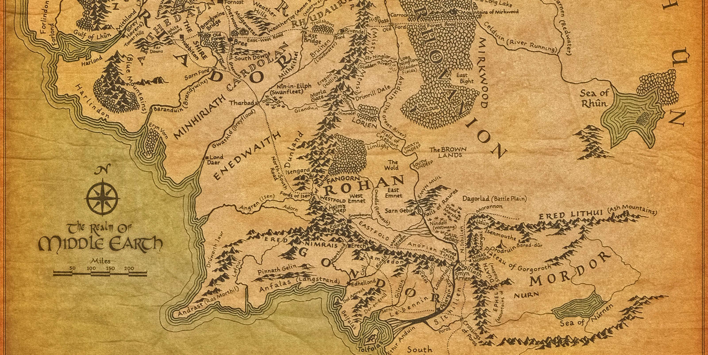



Notes:
If the people you’ve hired have built a mature DevOps and cloud company they already know about serverless and love it, and probably are already using it
If the people you’ve hired haven’t built a mature DevOps and cloud company
If they would like to but can’t for whatever reasons, they likely know about serverless and have used it on side projects and love it
If they aren’t pushing for DevOps or cloud there’s a good chance they don’t know anything about serverless (or DevOps practices in general)
Know the group you are working with

Slide 49

Challenges
Notes:
Retailers run large off the shelf software packages, how to incorporate serverless models around it

Slide 50







Where it’s already started

Slide 52
Customer
Visible
Value chain
Invisible
Manipulate
pictures
Share, view, comment, like pictures
Upload
pictures
App
Platform
Compute
Storage
Data center
Power

Slide 53

Customer
Visible
Value chain
Invisible
 | Genesis | Custom Built | Product / Rental | Commodity + Utility
 | Evolution
Manipulate
pictures
Share, view, comment, like pictures
Upload
pictures
App
Platform
Storage
Compute
Data center
Power

Slide 54
Customer
Visible
Value chain |  |  | s
Invisible
 | Genesis | Custom Built | Product / Rental | Commodity + Utility
 | Evolution
Manipulate
pictures
Share, view, comment, like pictures
Upload
pictures
App
Platform
Compute
Storage
Data center
Power

Slide 55

What does it mean for my people?
Solutions Architect
(Bit blueprint creator)
Data Architect
(Stores bits, manages
access)
Developer
(Describes how to
move bits)
Team Lead
(Keeps bit machine
well-oiled)
Product owner
(Talks to customer,
attempts to talk to
bit-team)
Release Engineer
(Moves bits)
Ops Engineer
(Watches bits)
Security Engineer
(Describes how bits are
allowed to move)
Manager
(Fits bits on calendar)

Slide 56
And how the communicate?
Solutions Architect
(Bit blueprint creator)
Data Architect
(Stores bits, manages
access)
Developer
(Describes how to
move bits)
Team Lead
(Keeps bit machine
well-oiled)
Product owner
(Talks to customer,
attempts to talk to
bit-team)
Release Engineer
(Moves bits)
Ops Engineer
(Watches bits)
Security Engineer
(Describes how bits are
allowed to move)
Manager
(Fits bits on calendar)

Slide 57
And what products do they support?
Is this customer-centric?

Slide 58
Product Teams
More customer-centric, means ☺’er customers

Slide 59
Don’t fire your way to innovation
Instead, seek to merge skill with responsibility
Your people, instead of being glorified bit managers, can do what they are good at – injecting creativity
Creativity ¹
Skill
Responsibility
¹ what people are still better at than computers, for the time being

Slide 60
But what about governance?
“We standardized on Java!”
“We only run [insert OS here]!”
“We only use [insert framework here]!”
The above are the result of trying to solve the Principal-agent problem: “the agent knows some things that the principal does not, and it is too costly for the principal to monitor every action that the agent take” (“Misbehaving: The Making of Behavioral Economics.”)
So instead of monitoring every action, the principal (IT Governance) reduces the jurisdiction(?), and thus cost, to govern.

Slide 61
The dark underbelly of limiting choice
By being prescriptive about standards, you’ve succeeded in reducing the governance cost
(Applause!)
But you’ve prohibitively raised the cost of experimentation.
Your talented high-dollar developers can only use the hammer you’ve provided.
(Insert Hammer/Nail)
Don’t be surprised if your talent leaves
Or worse, you talent only starts to see nails.

Slide 62
So you are proposing the wild west, except with modern weapons?
No.
With evolutionary architectures, strict data access policies, serverless technologies, and infrastructure-as-code, you can simultaneously allow variation and have cheaper, more reliable IT governance that you ever imagined possible.
The tools aren't here yet, but they’re coming quick.

Slide 63
Adoption Paths
Build vs Buy equation begins to change
If you have to customize *anything*, you may want to build
Come back to activation energy
Experiment with internal tools
Greenfield “Shining City on the Hill” model
Skunkworks
Others?

